Slide 1
Energy Consumption Analysis
Data Analysis Project

Slide 2
Problem Statement:
Project will analyze energy usage and greenhouse gas (GHG) emissions of Ontario's Broader Public Sector (BPS) organizations, leveraging a comprehensive database of reported data. We aim to identify trends, assess conservation effectiveness, and pinpoint areas for improvement, informing data-driven strategies to achieve climate change mitigation goals within the BPS.
Data Understanding:
The Dataset spans from 2012 to 2021 and contains information about BPS organizations, including public hospitals and school boards.Key attributes include organization details, operational information, energy consumption data, and GHG emissions.

Slide 3
Key Features:
Sector: Represents the sector of the organization (e.g., Public Hospital, School Board).
SubSector: Provides further classification within the sector.
Organization: Name of the BPS organization.
Operation: Specific operation or facility within the organization.
Address, City, Postal Code: Location details of the organization.
Energy Usage: Information about electricity, natural gas, fuel oil, propane, coal, wood, district heating, and district cooling consumption.
GHG Emissions: Greenhouse gas emissions in kilograms.

Slide 4
Tools Used
Python on Google colab:
Language of choice for data analysis and manipulation.
Utilized powerful libraries like Pandas for data manipulation and analysis.
Pandas: (Used to & read the files)
Key library for data manipulation and analysis.
Used for cleaning, transforming, and analyzing the dataset efficiently.
Matplotlib:
Employed for creating static, interactive, and animated visualizations in Python.
Ideal for generating plots, charts, and graphs.
Seaborn:
Built on top of Matplotlib, providing a high-level interface for statistical graphics.
Used for creating aesthetically pleasing and informative statistical graphics.

Slide 5
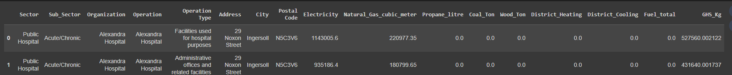
Approaches
Loaded the data from the Given dataset.
Transform the data to appropriate form like combining the multiple parts of data into single for using data manipulation.
Clean the data for data manipulation, removing Null values, duplicates. Sample data as follows.

Slide 6
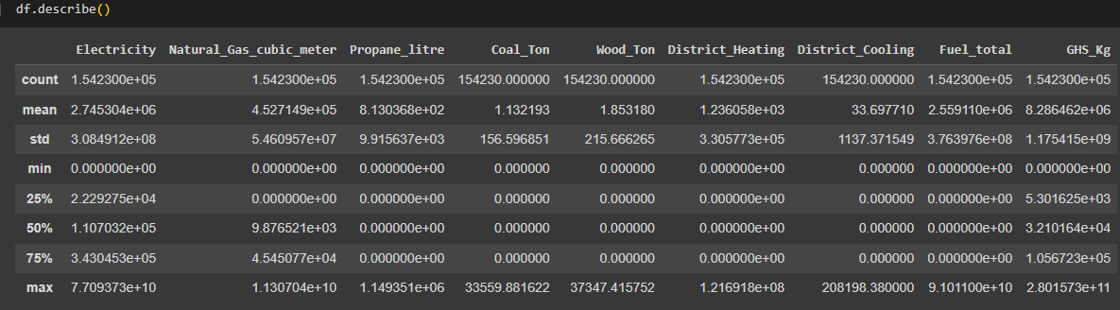
EDA insights….
Starts with the statistical information of the numerical columns in the dataset like Electricity, NO2, Propane litre for GHS.

Slide 7
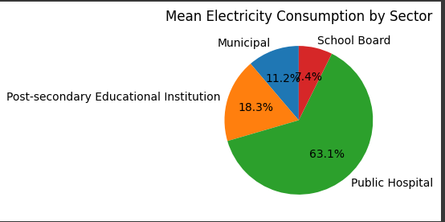
Factors which affects on GHS:
Electricity:
Electric power plays a huge role on sector wise.
We can see public hospital contributes high electric power while comparing to other sectors
Several factors can contribute to public hospitals having high electric power greenhouse gas emissions. It's important to note that specific reasons can vary based on the hospital's location, infrastructure, energy sources, and operational practices.

Slide 8
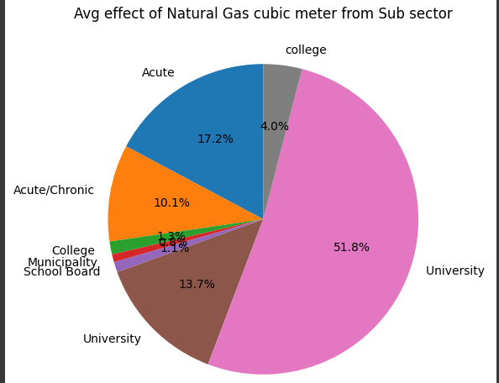
Effect of Natural gas – sub sector wise:
The contribution of natural gas to greenhouse gas emissions in a university setting can be influenced by various factors like Heating and cooling systems infrastructured, cooking facilities, water heating using Natural Gas.
To address and mitigate the impact of natural gas on greenhouse gas emissions, universities can consider implementing energy efficiency measures, investing in renewable energy sources, upgrading infrastructure, and adopting sustainable practices in various aspects of campus operations. Conducting a comprehensive energy audit and developing a sustainability plan can guide the university toward a more environmentally friendly energy profile.

Slide 9
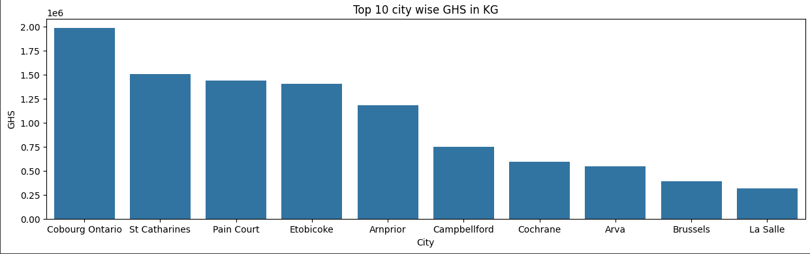
Top 10 city wise GHS:
Below are the 10 top city which had high GHS. They are
'Cobourg Ontario', 'St Catharines', 'Pain Court', 'Etobicoke', 'Arnprior', 'Campbellford', 'Cochrane', 'Arva', 'Brussels', 'La Salle‘.

Slide 10
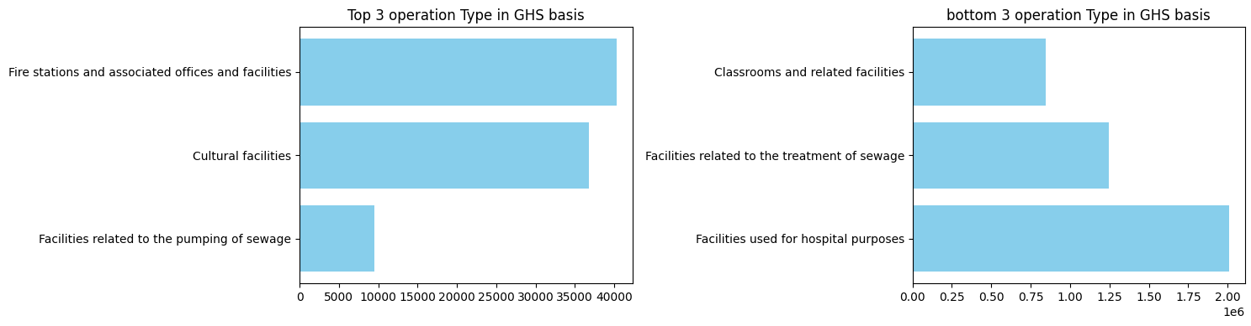
3 Top & Bottom GHS on Operation type.

Slide 11
Conclusion:
Analysing Greenhouse Gas Emissions in Ontario's Broader Public Sector
Through a comprehensive examination of energy usage and greenhouse gas (GHG) emissions within Ontario's Broader Public Sector (BPS), this project aimed to shed light on key trends, assess conservation effectiveness, and identify areas for improvement. The analysis of the dataset encompassing various sectors and sub-sectors revealed several noteworthy insights.
Overview of Greenhouse Gas Emissions:
The Broader Public Sector in Ontario collectively emitted a total of [5.166000e+03] kilograms of greenhouse gases during the reporting period. This represents a critical benchmark for understanding the environmental impact of BPS organizations in the region.
In which Public Hospital had 63.71% of total GHS while comparing to other sectors.
While checking the city wise data, Cobourg Ontario had high GHS emmission which is around 2 KG of GHS.
Coming to Operation type: Top most 3 operation types are Fire station, cultural, facilities related to pumping sewage. Yes, these 3 requires high energy, hence its contribution is high in GHS emmissions.
Recommendations for Improvement:
Based on the analysis, we recommend a multi-faceted approach to reduce emissions. This includes exploring renewable energy sources, implementing energy-efficient technologies, and fostering collaboration among BPS organizations to share best practices
Thank You

